Slide 1
OCTOBER 7TH MEMORIAL

Slide 2
Welcome.
Please silence your phones.

Slide 3
Remember
the Fallen

Slide 4
1,500+
101
MURDERED
HOSTAGES
86,500+
ISRAELIS DISPLACED FROM THEIR HOMES
9,300+
15,100+
ROCKETS FIRED
TOWARDS ISRAEL
INJURED
#

Slide 5
Learn from
Survivors

Slide 6
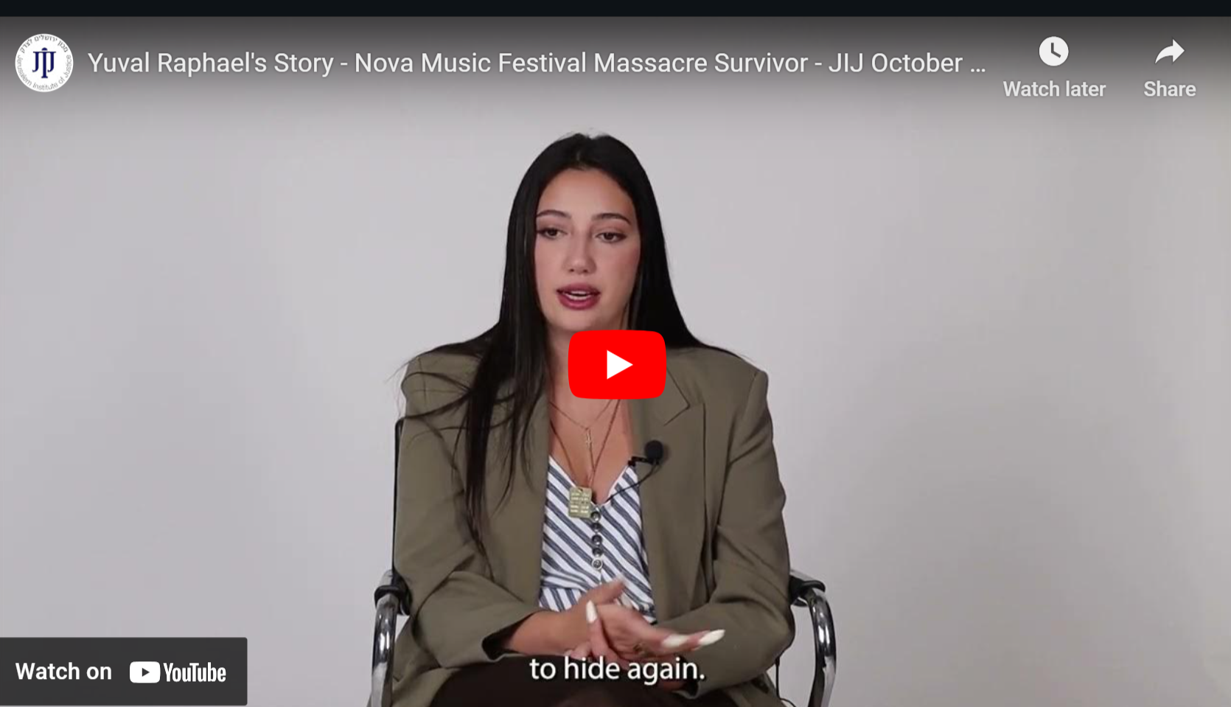
https://www.youtube.com/watch?v=ve0T0qzWLrM

Slide 7
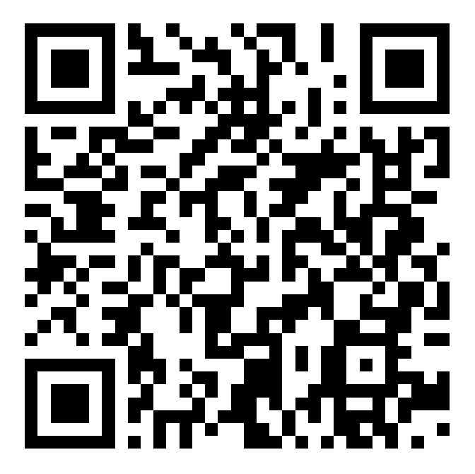
Support Survivors in
Sharing their Stories
Crowdfund the Documentary:

Slide 8
Honor the
Soldiers

Slide 9
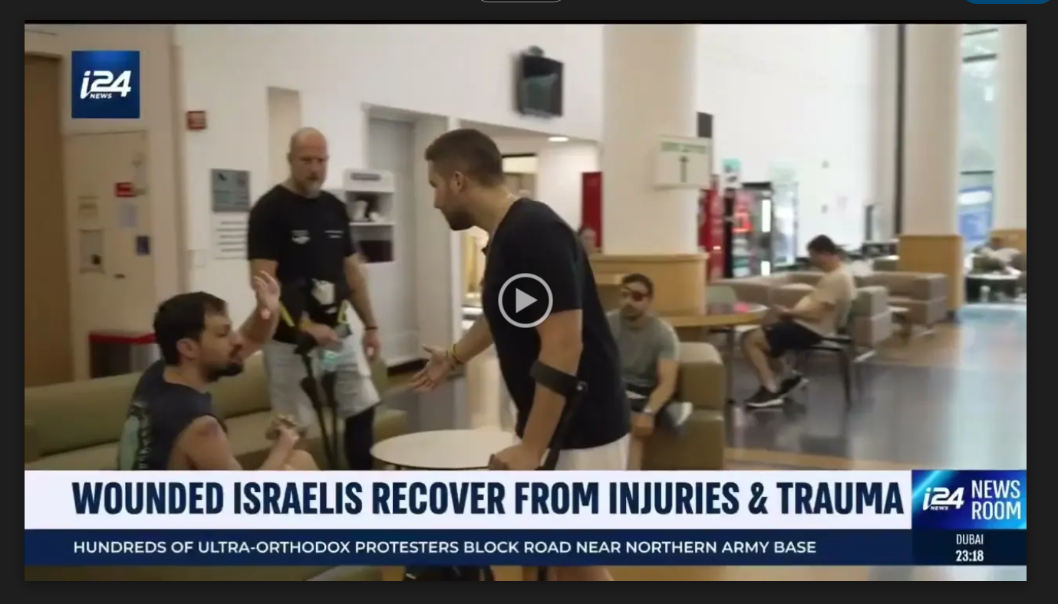

Slide 10
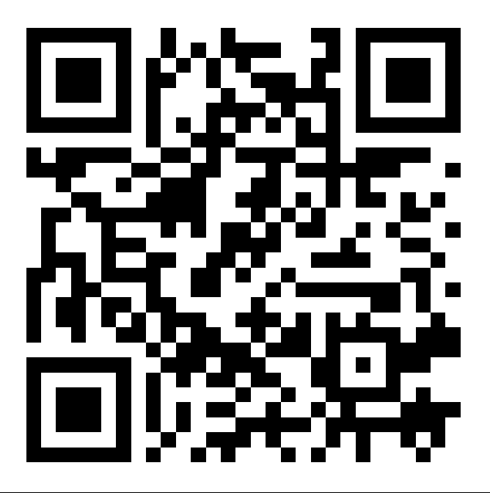
Free Legal Aid for
Wounded Israeli Soldiers
DONATE:

Slide 11
Stand with
the Hostages

Slide 12
Thank you for
standing with Israel

